Slide 1

Bank Loan of Customers Data Analysis - P425
Group-3:-
Varad Sanjay Disale
Minku Raj
Kishorekumar P
Rushikesh Hanmant Patil
Shankargouda R K.

Slide 2
Content
Introduction
Project Objectives
KPI’s
Dashboard's
Conclusion

Slide 3
Introduction
Banks play a pivotal role in the economy by facilitating financial transactions, providing loans, managing deposits, and offering various financial services.
By acting as a middleman between savers and borrowers, they foster stability and economic progress. The context for examining the complex operations, difficulties, and importance of banks in contemporary society is established by this introduction.
Examining banks entails evaluating their performance, risk management, market positioning, and financial stability. Determining resilience, profitability, and systemic impact is critical for regulators, policymakers, and investors alike. We can comprehend operational effectiveness, capital sufficiency, and compliance with regulations through thorough assessments, which are essential for making well-informed decisions in the financial arena.

Slide 4
Project Objective
The project aim to analyze the Finance dataset of bank loan of customers, through a report to get insights.
we were provided with 2 datasets with csv extension files having 39k rows each and the objective was to analyze the growth that bank got within given years in loans.
We used MS-Excel, MySQL for analyzing, cleaning and removing duplicates from dataset and prepared dashboard using Tableau and PowerBi tools where we did calculations, merging and prepared interactive dashboards.

Slide 5
Key Performance Indicators(KPI)
KPI-1: Year Wise Loan Stats
KPI-2: Grade and Sub Grade wise Revolving Balance
KPI-3: Total payment for Verified status and Non-Verified status
KPI-4: State wise and Last_credit_pull_d wise loan status
KPI-5: Home Ownership Vs Last Payment Date stats

Slide 6
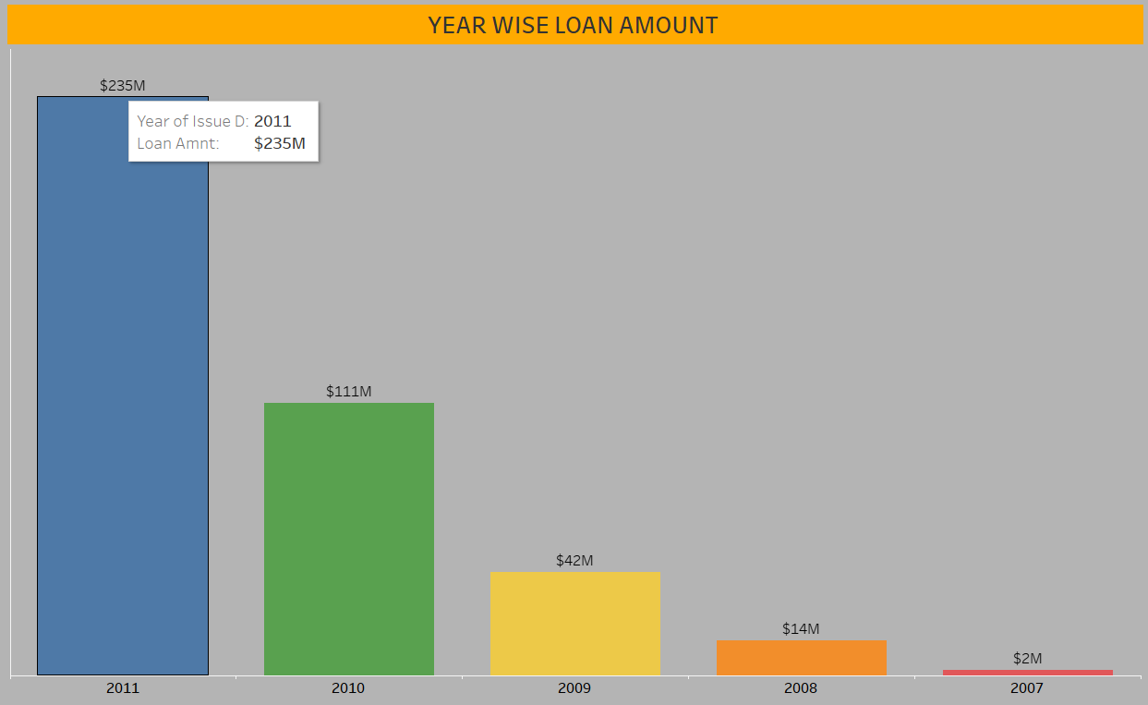
Year wise Loan Status
In this chart , we can see that requirement of the loan amount has increased significantly YoY roughly 2,3 times since 2007.
From the year 2009, The changes in loan amount is suddenly increased with a higher rate that is around 5 times higher rate for next 2 years as compared to previous 2 years.

Slide 7
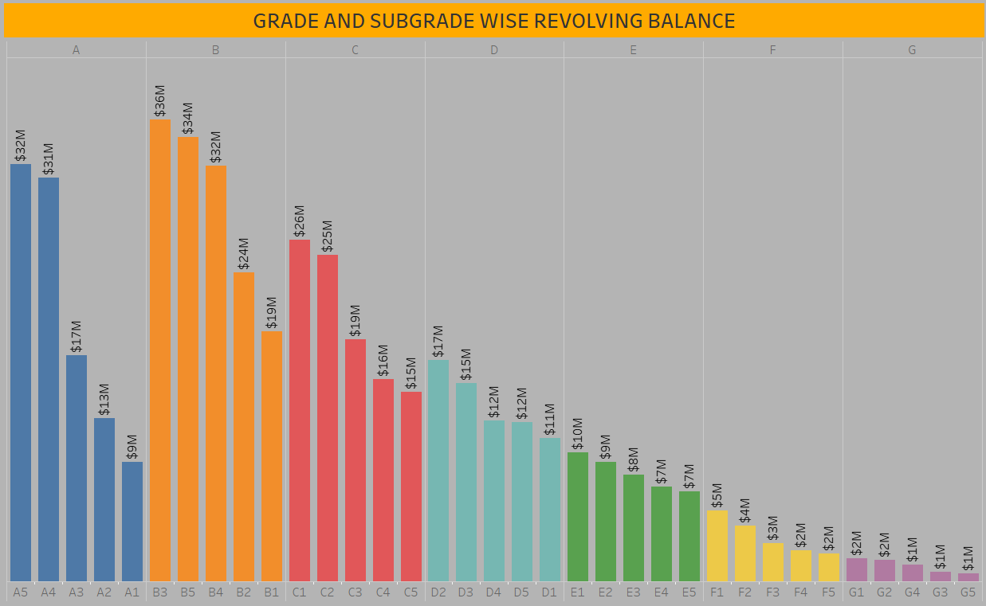
Grade and Sub Grade wise Revolving Balance
The revolving or revolving balance means unpaid balance carried forward every month on that loan.
In this Grade and subgrade wise revolving balance we can notice Grade-B have more revol balance then any other grade & Grade-G have very low revolving balance.
Similarly, by Subgrade wise subgrade B3 has highest revolving balance which Is 35.6 million dollars and subgrade G5 has lowest revolving balance which is 0.6 million dollars .

Slide 8
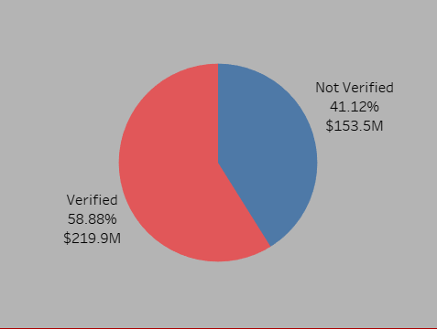
Total payment for Verified status Vs Non-Verified status
This is the first stage of the verification process. The bank needs a loan application to initiate the document collection and verification process.
Looking at pie chart out of Total Payment 58.88% are having Verified Status and 41.12% have Non-Verified Status.

Slide 9
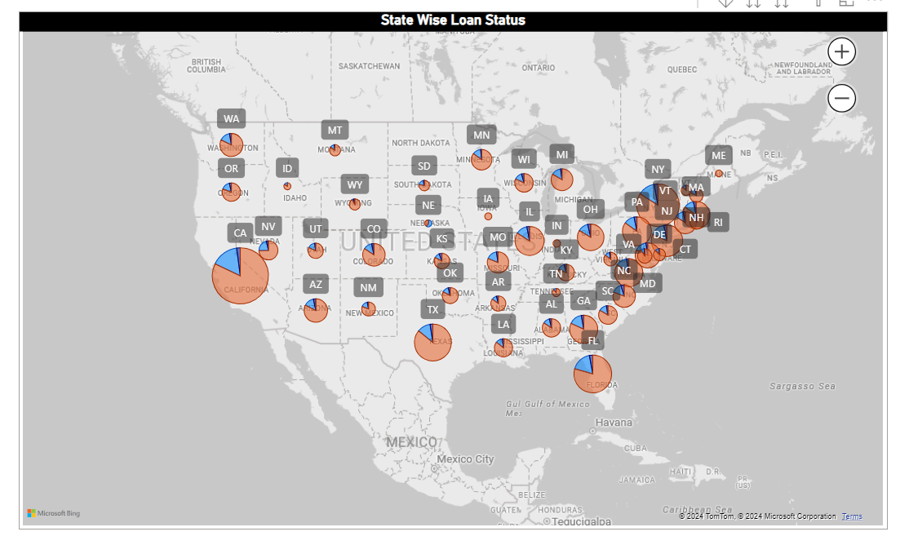
State wise and Last_credit_pull_d wise loan status
The right graph shows the count of Loan Status in each state of USA on particular last credit pull date.
As you see from the representation, State ‘CA’ has the highest number of accounts in each type of loan status specially fully paid accounts. And state ‘ME’ has the lowest number of accounts in each type of loan status.

Slide 10
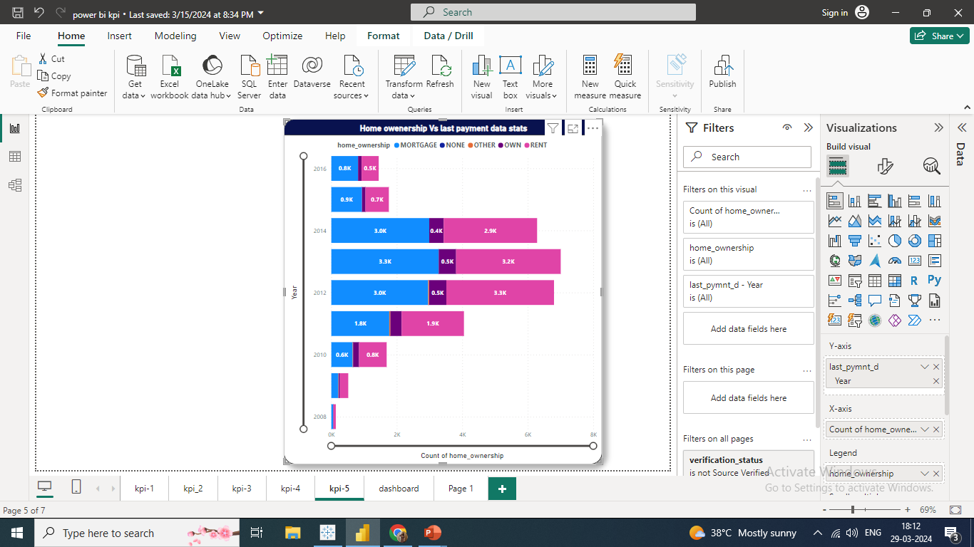
Home Ownership Vs Last Payment Date stats
The right graph shows the Home ownership and the amount paid for each on last payment date.
The type of amount of Home ownership varies from 2008 to 2016. And the maximum amount reaches in year 2012, That is around 31M. And the minimum amount is in 2008.
Except NONE and OTHERS, all other Home ownership has maximum took loan for debt consolidation. So, recently paid max amount is of MORTGAGE followed by RENT and OWN.

Slide 11
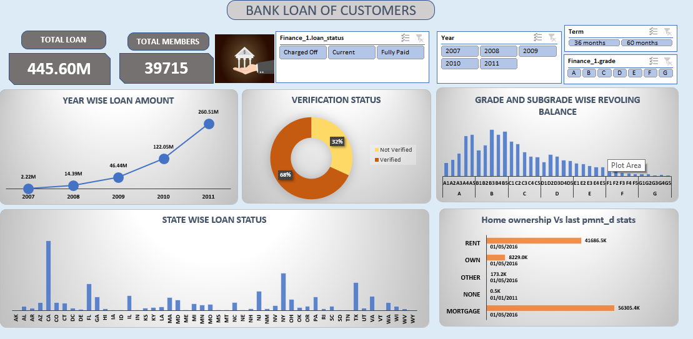
Excel Dashboard

Slide 12
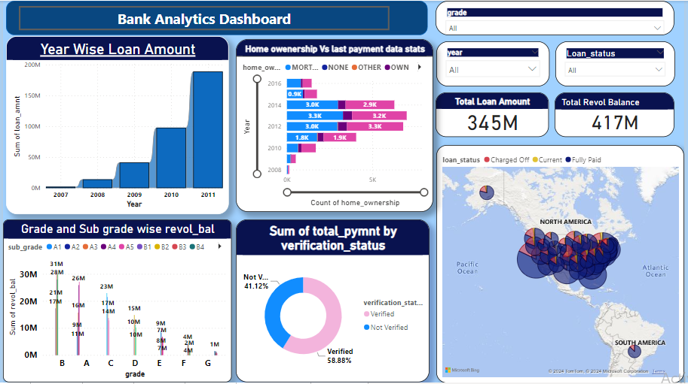
Power Bi Dashboard

Slide 13
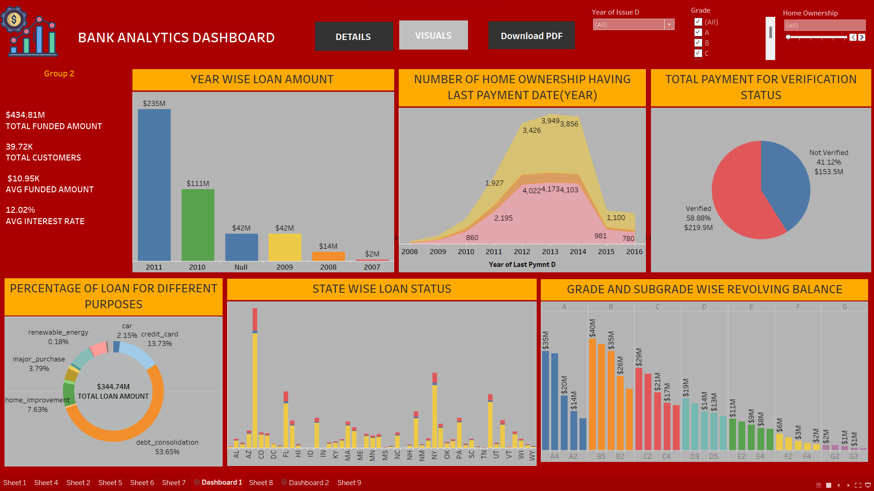
Tableau Dashboard

Slide 14
Conclusion
The year wise loan stats is continuously increasing by each year as it‘s varies from 2.22M to 260.51M between the years 2007 to 2011.
The Grade and Sub Grade wise Revolving Balance show high revolving balances may indicate that a borrower is relying too much on credit. B>A>C>D>E>F>G is the Grade order for Revolving Balance maximum to minimum as per annual income.
The total payment for verified account is higher as compared to non-verified. Total payment for status verified is around 220 million dollars and Non- verified is 153.5 million dollars.
The State wise and Last_credit_pull_d wise loan status show 50 states to which bank has granted loan for various purpose. In that California has granted highest loan to customers and Maine has lowest.
The average annual income was higher for customer with Mortgage home ownership status compared to Rent & Own status.

Slide 15


